Slide 1
BUILDING SIMPLE GUI CALCULATOR USING Python:
An Internship Project - I

Slide 2
Introduction -
A simple Calculator program using Tkinter.
Built using Python programming language.
Provides basic arithmetic operations.
Python is a popular programming language it was Created by Guido van Rossum, and released in 1991-

Slide 3
It is used for:-
Web development (server-side).
software development
Mathematics
System scripting.

Slide 4
The biggest strength of Python is huge collection of standard libraries which can be used for the following GUI Applications (like kivy, Tkinter PyQt etc)
Machine Learning
Web Scraping
Test framework
Multimedia
Scientific computing and many more

Slide 5
TOOLS AND TECHNOLOGIES
Tools – python,Vscode
Python libraries – tkinter

Slide 6
Tkinter -
Tkinter is the standard GUI – library for Python. Python when combined with Tkinter provides a fast and easy way to create GUI applications.

Slide 7
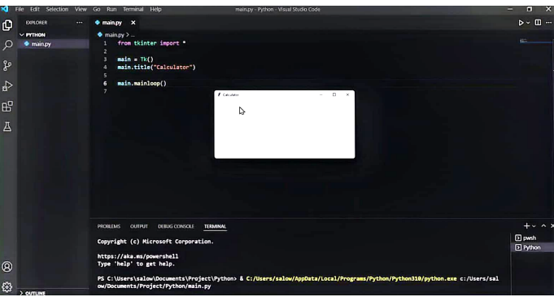
STEP'S to build Calculator
Step 1.
Import library Tkinter
from tkinter import *
Step 2.
Assign top level widget which represents main window of application-
main = Tk ()
main.mainloop()
Step 3.
Assign the Title.
main.title ("Calculator")

Slide 8
Step 4.
Create a variable called operator and assign it to empty string.
Operator = " " (used to perform operation such as add, Sub, multiply, division etc)
Step 5.
Create variable input value & assign to StringVar function.
*StringVar a string is used to hold the value for Variable.

Slide 9
User Interface
The Calculator has clean and user friendly interface.
Consists of buttons for numbers and operators.
Includes an entry field for input and display.

Slide 10
INPUT AND OUTPUT
User can enter numbers by clicking the corresponding buttons.
The result calculator displays the input and the in the entry field.
Clear (C) button resets the input and output.

Slide 11
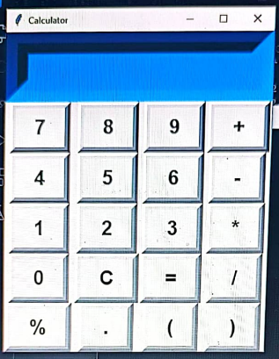
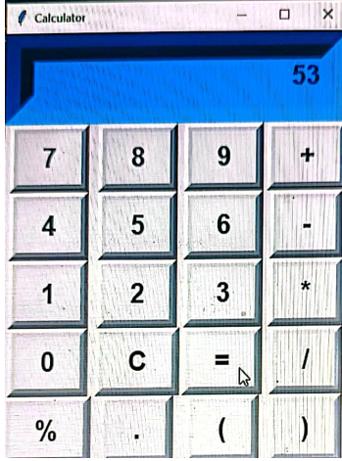
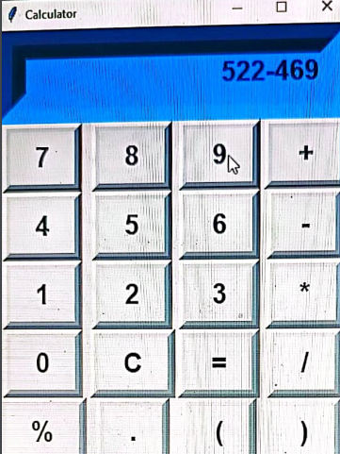
CALCULATOR IS READY

Slide 12
CONCLUSION
A Simple Calculator program built with Tkinter.
Provides basic arithmetic operations with a user-friendly interface.
customizable and can be extended with additional features if desired.

Slide 13
Thank You

